Slide 1

St. Francis Institute of Technology Department of Computer Engineering
Profit Maximization
Group Members:
Under the guidance of
Mrs. Vincy Joseph
Aishwarya John
Anashwara Kurien
Sherwin Lobo

Slide 2
Content
Introduction
Problem Statement
Proposed Solution
Work Flow of the system
Algorithm with Implementation details
Experimental Set Up
Data Set
Performance Evaluation Parameters
Results & Discussion
Conclusion
References

Slide 3
Introduction
Profit maximization is the process of selecting the best portfolio out of the set of all portfolios being considered.
This is based on maximizing returns and minimizing profits.
Societal Impact: - It will benefit business, finance, small and large scale sectors greatly as it will help the users to make wise investment choices.

Slide 4
Introduction
Application: Banking sector, finance, healthcare, IT, foreign exchange, etc.
Research: All the researches that have been conducted till date follow the Modern Portfolio Theory.
However this project integrates classical mean-variance optimization techniques and Black-Litterman allocation, as well as sample covariance matrices.

Slide 5
Problem Statement
To maximise profits and at the same time reduce risks during investment. Strongly correlated components contribute to a weak portfolio.
Hence, the portfolio should be maximised by having a negative correlation among its components to guarantee maximum returns.
Proposed solution: Use the PyPortfolioOpt function, which uses mean-variance technique to optimize user’s portfolio.

Slide 6
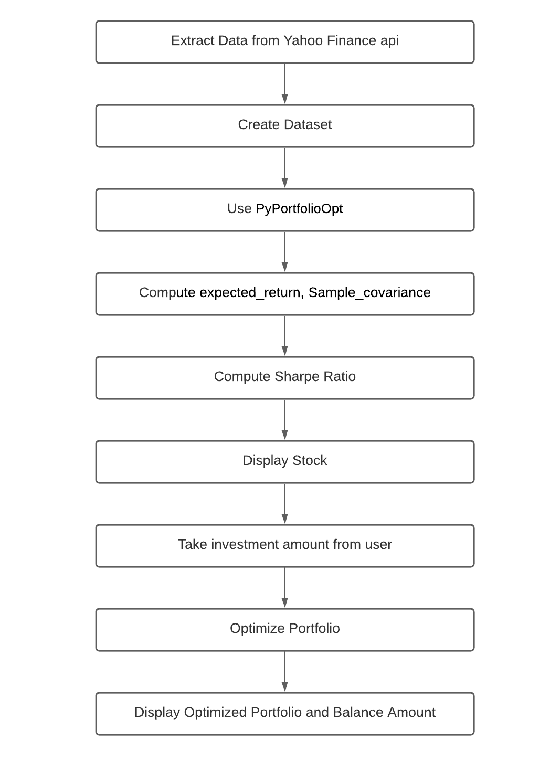
Work Flow of the system
Web scraping the dataset.
Compute sample_covariance,sharpe ratio returns and volatility.
Display stock information.
Enter investment amount and capitalization category.
Display optimized portfolio along with the balance amount.

Slide 7
Algorithm
1. Get historical data
2. Calculate expected returns and covariance matrix(Risk model)
3. Calculate sharpe ratio and Optimise portfolio
4. Diversified portfolio
5/29/2021
Profit Maximization

Slide 8
Algorithm with Implementation Details
For optimizing the portfolio, a function called PyPortfolioOpt is used.
PyPortfolioOpt is a library that implements portfolio optimization methods, including mean-variance optimization techniques and Black-Litterman allocation.
It first computes the mean- variance (MV) and the sample covariance.
Then the sharpe ratio is calculated and based on all these parameters the portfolio is optimized.

Slide 9
PyPortfolioOpt
It is extensive yet easily extensible, and can be useful for both the casual investor and the serious practitioner.
Exponentially weighted mean historical returns
Minimum Covariance Determinant
Sample covariance matrix

Slide 10
Experimental Setup
The dataset consists of various attributes like- ticker symbol, opening price, close price, trading volume and adjacent close.
For calculating the percentage change in returns and volatility we have made use of the close price attribute.
The Sharpe Ratio was used as a parameter to measure the risk adjusted return of a portfolio which should be above 1.0

Slide 11
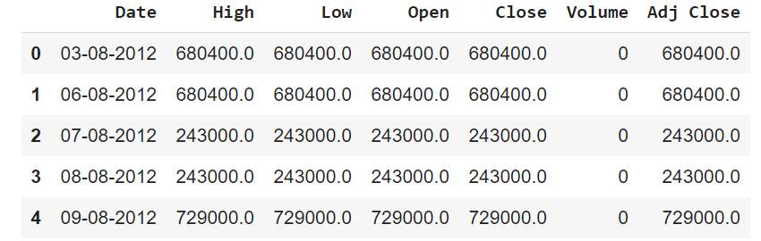
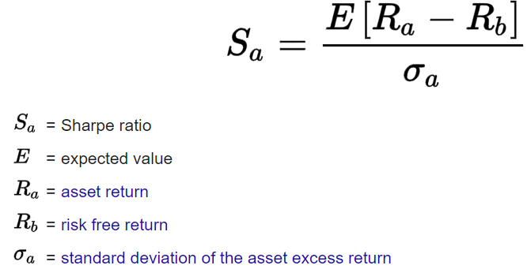
5/29/2021
Profit Maximization

Slide 12
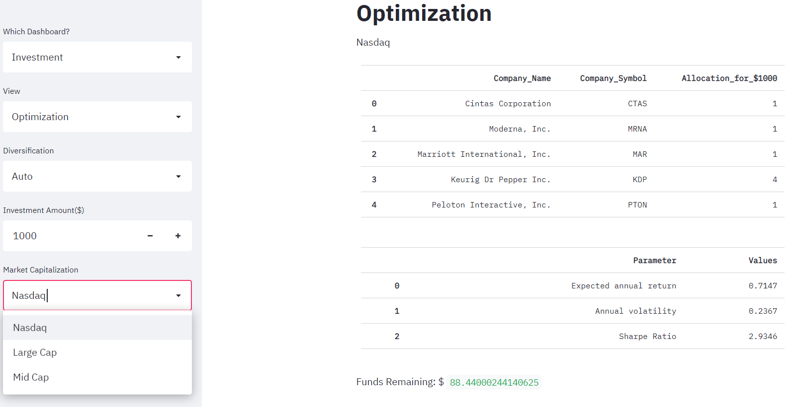
Results and Discussions

Slide 13
The user can choose one of the three market capitalizations: - Nasdaq (first 100), large cap (101 to 250) and the mid cap (others).
The user will be displayed the expected returns, balance and volatility according to which he/she can make the choice.
The optimized portfolio is obtained.
5/29/2021
Profit Maximization

Slide 14
Conclusion
Through this project, we learnt about portfolio diversification and optimization.
The function PyPortfolioOpt was used to optimize the portfolio according to the user’s investment amount.
This method is highly efficient and can be used in various fields like finance, healthcare, business, etc.

Slide 15
References
[1] R.A. Haugen, N.L. Baker, Dedicated stock portfolios, Journal of Portfolio Management, 16 (1990), 17-22.
[2] T-J Chang, Nigel Meade, John E Beasley, and Yazid M Sharaiha. 2000. Heuristics for Cardinality Constrained Portfolio Optimisation. Computers & Operations Research 27, 13, 1271--1302.
[3] P. Xidonas, G. Mavrotas, J. Psarras, Portfolio construction on the Athens Stock Exchange: A multiobjective optimization approach, Optimization, 59 (2010), 1211-1229.
[4] Francesco Cesarone, Andrea Scozzari, and Fabio Tardella. 2009. Efficient Algorithms for Mean-Variance Portfolio Optimization With Hard Real-World Constraints. Giornale dell'Istituto Italiano degli Attuari 72, 37--56
[5] R. Mansini, W. Ogryczak, M.G. Speranza, Portfolio optimization and transaction costs. In Quantitative financial risk management: Theory and practice, Oxford: Wiley (2015), 212-241.

Slide 16
Thankyou !!!
Q & A ??

